Slide 1

Welcome!
Workshop #4: Databases & SQL
Martin Pollack – DASIL Mentor
Emma Gaydos – DASIL Mentor
David Dai – DASIL Mentor
Template taken from slidesgo.com

Slide 2
Outline
What is a database?
Relational databases
SQL
Non-relational databases

Slide 3
What is a Database?
“An organized collection of structured information, or data, typically stored electronically in a computer system” (Oracle)

Slide 4
What is a Database?
Organized
The data is arranged in a systematic way
Alphabetical order
Chronological order
From least to most
And so on!
“An organized collection of structured information, or data, typically stored electronically in a computer system” (Oracle)

Slide 5
What is a Database?
Organized
The data is arranged in a systematic way
Alphabetical order
Chronological order
From least to most
And so on!
Composed of Data
Pieces of information: Recorded facts, observations, numbers, events, etc.
Student addresses
Survey responses
Heights and weights
And so on!
“An organized collection of structured information, or data, typically stored electronically in a computer system” (Oracle)

Slide 6
Quiz!
A
A telephone book
B
Papers in a filing cabinet
Which of these is a database?
C
NetNutrition
D
Google scholar

Slide 7
All of the above!
✓
A telephone book
✓
Papers in a filing cabinet
Which of these is a database?
✓
NetNutrition
✓
Google scholar

Slide 8
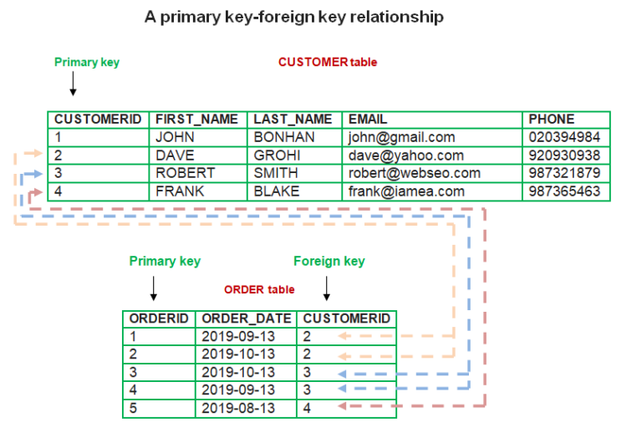
What is a Relational Database?
A relational database organizes data into tables that are related to each other by…
Breaking data into multiple tables, each composed of columns and rows…
…in which the datatypes are defined by column (integers, images, etc.)...
…and the rows are uniquely identified by a Primary Key Column (CustomerID, OrderID, etc.).
Source: Online Open Academy
Rows in one table are related to rows in another table by a Foreign Key Column, which is the Primary Key Column for another table.

Slide 9
In order to communicate with relational databases, we need...

Slide 10
Structure Query Language (SQL)
Programming language with simple syntax
Supports all "CRUD" operations:
Create entries
Retrieve information (or query)
Update information
Delete information
Different Relation Database Management Systems (RDBMS) have different variants of SQL:
MySQL
PostgreSQL
SQLite
SQL Server
But most things (like those covered today) are the same

Slide 11
Example Database
"student" table
student_ID | first_name | last_name | class_year | age | major | home_state
1 | Martin | Pollack | 4 | 21 | Mathematics | California
2 | Emma | Gaydos | 4 | 22 | Psychology | Colorado
3 | David | Dai | 3 | 21 | Economics
"DASIL_sign_in" table
log_ID | student_ID | time
1 | 1 | 2022-02-20 10:41:27
2 | 2 | 2022-02-20 11:24:59
3 | 1 | 2022-02-20 13:01:00
4 | 1 | 2022-02-20 15:51:28
5 | 1 | 2022-02-20 22:37:48
6 | 2 | 2022-02-20 22:40:01

Slide 12
Our first SQL Query
SQL consists of KEYWORDS in all caps and values
Get all columns from a "students" table:
SELECT *
FROM students
student_ID | first_name | last_name | class_year | age | major | home_state
1 | Martin | Pollack | 4 | 21 | Mathematics | California
2 | Emma | Gaydos | 4 | 22 | Psychology | Colorado
3 | David | Dai | 3 | 21 | Economics

Slide 13
To select certain columns, list them separated by commas.
To select fewer rows, use the LIMIT keyword to specify how many.
If you want to rename a column, use AS
SELECT first_name AS first, last_name AS last
FROM students
LIMIT 1
first | last
Martin | Pollack

Slide 14
We can also select fewer rows by only getting those that meet a condition using WHERE
SELECT first_name, last_name
FROM students
WHERE age = 21
AND (major = 'Mathematics' OR major = 'Biology')
AND NOT home_state = 'California'
first | last
Exercise: Navigate to sql-practice.com. In the top-right, select "View All Questions" and then the first "Easy" problem.

Slide 15
Missing values are represented as NULL
To test if something is NULL or not, we use IS or IS NOT, respectively
SELECT first_name, last_name
FROM students
WHERE home_state IS NOT NULL
first | last
Martin | Pollack
Emma | Gaydos
Exercise: Do the second "Easy" problem at sql-practice.com.

Slide 16
But we do not always have to return just raw values from our tables
We can list the distinct values in a column with, you guessed it... DISTINCT!
SELECT DISTINCT major
FROM students
major
Mathematics
Psychology
Economics

Slide 17
Another useful function is COUNT()
If * passed, gives number of rows
If column passed, gives number of rows that are not NULL
SELECT COUNT(*), COUNT(home_state), COUNT(DISTINCT major)
FROM students
COUNT(*) | COUNT(home_state) | COUNT(DISTINCT major)
3 | 2 | 3
Exercise: Do the last "Easy" problem at sql-practice.com.

Slide 18
We can do also do math on columns!
SELECT MIN(age), MAX(age), AVG(age)
FROM students
WHERE major = 'Economics'
MIN(age) | MAX(age) | AVG(age)
21 | 22 | 21.33333

Slide 19
Or we can do math on multiple columns at once
SELECT age, year, age/year as age_divided_by_year
FROM students
WHERE major = 'Economics'
age | year | age_divided_by_year
21 | 4 | 5
22 | 4 | 5
21 | 3 | 7

Slide 20
COUNT(), MAX(), etc. aggregate over a whole table
But we can also calculate statistics for various groupings by adding a GROUP BY clause
SELECT major, AVG(age)
FROM students
GROUP BY major
major | AVG(age)
Mathematics | 21
Psychology | 22
Economics | 21

Slide 21
But WHERE cannot be used to filter on an aggregated column, like AVG(age)
Instead, we use HAVING
SELECT major, AVG(age)
FROM students
GROUP BY major
HAVING AVG(age) > 21
major | AVG(age)
Psychology | 22

Slide 22
Sorting by a column is easy: just use ORDER BY and the column name
By default, sorting is ascending. To make it descending, write DESC after the column name
SELECT first_name as first, class_year, age
FROM students
ORDER BY age DESC, class_year
first | class_year | age
Emma | 4 | 22
David | 3 | 21
Martin | 4 | 21
Exercise: Do the third to last "Easy" problem at sql-practice.com.
Then do the first "Medium" problem.

Slide 23
Sometimes we want to create new columns based on if/then logic
CASE makes this easy, just include it in the SELECT statement
SELECT first_name,
CASE WHEN age < 18 THEN 'under 18'
WHEN age <= 21 THEN '18-21'
ELSE 'over 21' END AS grouped_age
FROM students
first | grouped_age
Martin | 18-21
Emma | over 21
David | 18-21
Exercise: Do the second "Hard" problem at sql-practice.com.
Hint: POWER(num, exp) raises num to exp. Also, by default, "/" does integer division

Slide 24
But we may want to include multiple tables in a query...
Think about the following problem:
What is the average age of DASIL's visitors on February 20, 2022?
Age info comes from "students", but visiting info comes from "DASIL_log"

Slide 25
Use a Join!
Form a connection between tables by matching certain columns
Afterwards, we can access columns from either table at once
Four types of joins:
Inner, Outer, Left, Right

Slide 26
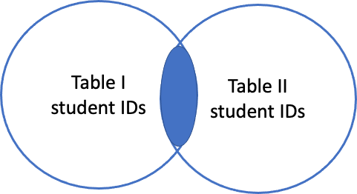

Inner Join
Returns rows where both tables have a match in the column of interest

Slide 27
Inner Join
log_ID | student_ID | time
1 | 1 | 2022-02-20 10:41:27
2 | 2 | 2022-02-20 11:24:59
3 | 1 | 2022-02-20 13:01:00
4 | 1 | 2022-02-20 15:51:28
5 | 4 | 2022-02-20 22:37:48
6 | 2 | 2022-02-20 22:40:01
student_ID | first_name
1 | Martin
2 | Emma
3 | David
student_ID | log_ID | first_name | time
1 | 1 | Martin | 2022-02-20 10:41:27
2 | 2 | Emma | 2022-02-20 11:24:59
1 | 3 | Martin | 2022-02-20 13:01:00
1 | 4 | Martin | 2022-02-20 15:51:28
2 | 6 | Emma | 2022-02-20 22:40:01

Slide 28
Inner Join
How to create a joined table in SQL:
SELECT *
FROM students
JOIN DASIL_log
ON students.student_ID = DASIL_log.student_ID
You can then use this new table to do anything we have done previously!

Slide 29
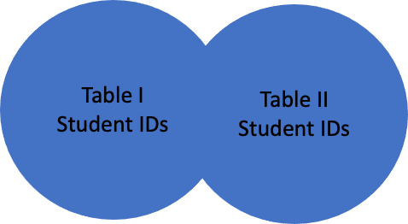
Outer Join
Returns all rows from both tables, if they have a match or not

Slide 30
Outer Join
student_ID | first_name
1 | Martin
2 | Emma
3 | David
log_ID | student_ID | time
1 | 1 | 2022-02-20 10:41:27
2 | 2 | 2022-02-20 11:24:59
3 | 1 | 2022-02-20 13:01:00
4 | 1 | 2022-02-20 15:51:28
5 | 4 | 2022-02-20 22:37:48
6 | 2 | 2022-02-20 22:40:01
student_ID | log_ID | first_name | time
1 | 1 | Martin | 2022-02-20 10:41:27
2 | 2 | Emma | 2022-02-20 11:24:59
1 | 3 | Martin | 2022-02-20 13:01:00
1 | 4 | Martin | 2022-02-20 15:51:28
4 | 5
2 | 6 | Emma | 2022-02-20 22:40:01
3 |  | David

Slide 31
Outer Join
SELECT students.first_name, DASIL_log.time
FROM students
OUTER JOIN DASIL_log
ON students.student_ID = DASIL_log.student_ID

Slide 32
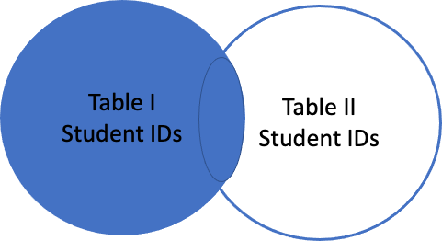
Left Join
Returns all rows in the left table, no matter if they have a match or not

Slide 33
Left Join
student_ID | first_name
1 | Martin
2 | Emma
3 | David
log_ID | student_ID | time
1 | 1 | 2022-02-20 10:41:27
2 | 2 | 2022-02-20 11:24:59
3 | 1 | 2022-02-20 13:01:00
4 | 1 | 2022-02-20 15:51:28
5 | 4 | 2022-02-20 22:37:48
6 | 2 | 2022-02-20 22:40:01
student_ID | log_ID | first_name | time
1 | 1 | Martin | 2022-02-20 10:41:27
2 | 2 | Emma | 2022-02-20 11:24:59
1 | 3 | Martin | 2022-02-20 13:01:00
1 | 4 | Martin | 2022-02-20 15:51:28
2 | 6 | Emma | 2022-02-20 22:40:01
3 |  | David

Slide 34
Left Join
SELECT *
FROM students
LEFT JOIN DASIL_log
ON students.student_ID = DASIL_log.student_ID
Note: In this case, "LEFT" refers to the first table we list after "FROM" and "RIGHT" refers to the second table we list after "JOIN".

Slide 35
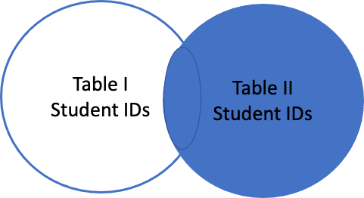
Right Join
Returns all rows in the right table, no matter if they have a match or not

Slide 36
Right Join
student_ID | first_name
1 | Martin
2 | Emma
3 | David
log_ID | student_ID | time
1 | 1 | 2022-02-20 10:41:27
2 | 2 | 2022-02-20 11:24:59
3 | 1 | 2022-02-20 13:01:00
4 | 1 | 2022-02-20 15:51:28
5 | 4 | 2022-02-20 22:37:48
6 | 2 | 2022-02-20 22:40:01
student_ID | log_ID | first_name | time
1 | 1 | Martin | 2022-02-20 10:41:27
2 | 2 | Emma | 2022-02-20 11:24:59
1 | 3 | Martin | 2022-02-20 13:01:00
1 | 4 | Martin | 2022-02-20 15:51:28
4 | 5 |  | 2022-02-20 22:37:48
2 | 6 | Emma | 2022-02-20 22:40:01

Slide 37
Right Join
SELECT *
FROM students
RIGHT JOIN DASIL_log
ON students.student_ID = DASIL_log.student_ID
Note: In this case, "LEFT" refers to the first table we list after "FROM" and "RIGHT" refers to the second table we list after "JOIN".

Slide 38
Join Practice Problems
5th to last "Easy" problem on sql-practice.com.
4th "Medium" problem on sql-practice.com.
3rd "Hard" problem at sql-practice.com.

Slide 39
How to order a complicated Query
SELECT _____
FROM _____
JOIN _____
ON _____
WHERE _____
GROUP BY _____
HAVING _____
ORDER BY _____

Slide 40
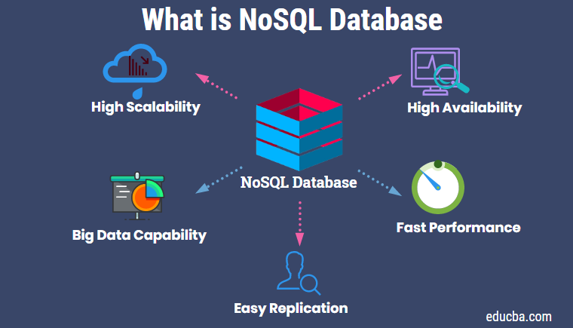
Non-relational databases (NoSQL)
Becoming increasingly popular
Broad term: any database not in a row-column format
Flexibility: Use storage model that is optimized for specific type of data being used
Can, but don’t have to use SQL for querying
Source: Educba.com

Slide 41
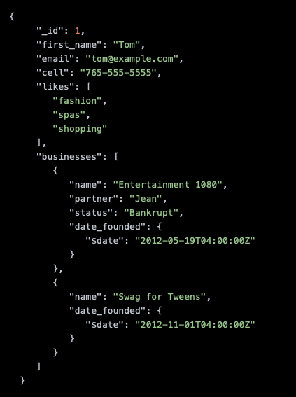
Document-Oriented Database
Each row is a document, which stores field-value pairs containing information on observations
Documents usually in XML, YAML, JSON
Basically like a collections of dictionaries/lists in Python
Align better with data structures in programming languages
Easier retrieval from/writing to database from apps
Flexibility on data to store/data types
Easily distributed
Most popular NoSQL database (e.g. MongoDB)
Source: MongoDB

Slide 42
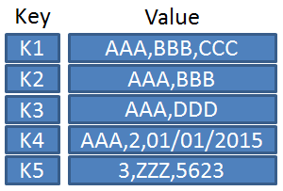
Key-Value Database
Each observation is a given a unique key
Key corresponds to value(s)
Very flexible, but only supports basic operations
Hard to merge different tables
Source: Database Zone

Slide 43
Column-Oriented Database
Relational databases are row-oriented
Easy to return all info for an observation
But all rows need to be considered for searches, even if missing data
Column-oriented database stores values by column
Record a column value and the row indices that have that value
Less wasted space
Easy to calculate summary statistics

Slide 44
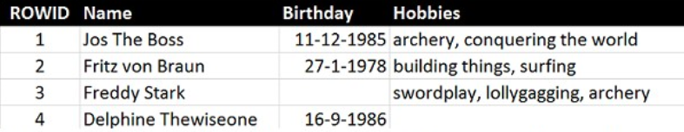
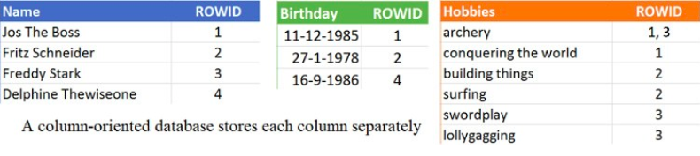
Row-based
Column-based
Source: Database Zone

Slide 45
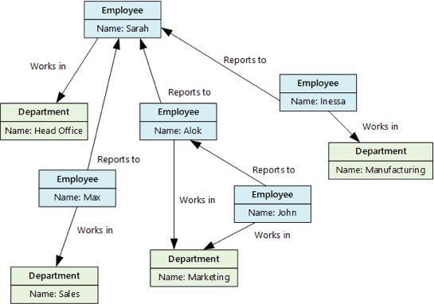
Graph Database
Store objects (nodes) and their connections to one another (edges)
Below, employees/departments are nodes, connected by working relationship
Easier to identify relationships between entities
Source: Microsoft Docs

Slide 46
Thank you!

